Slide 1
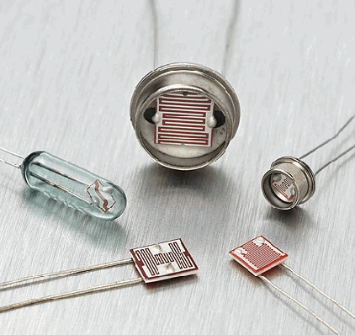
SENSORS
Photocells are a type of sensor.
In our next set of classes, we’ll learn how to use
various types of sensors .

Slide 2
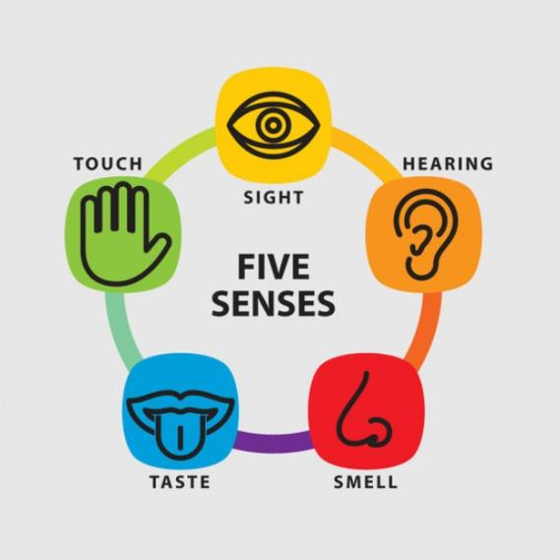
WHAT ARE SENSORS?
Our five senses give our brain information
about the world around us.
Sensors provide information to computers and other electronic devices.
Notes:
Consider our sensory organs
Eyes
Ears
Nose
Tongue
Nerves
They bring information to our brain, we can then use that information to make decisions.
We use sensors to bring information about the outside world into our computer.

Slide 3
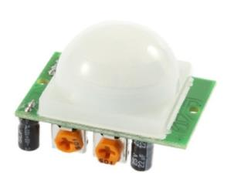
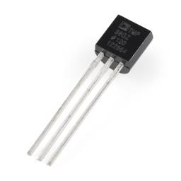
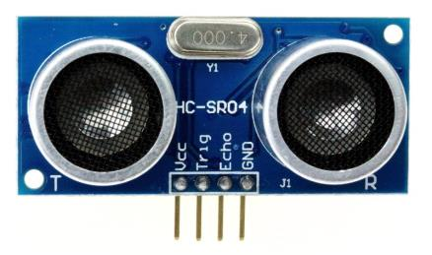
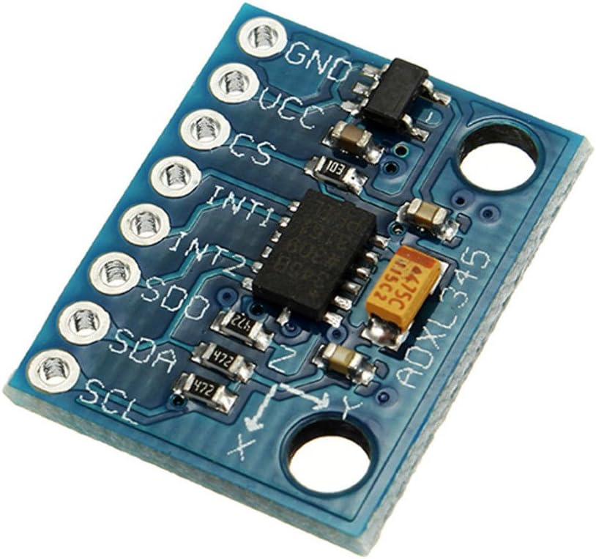
Arduino - Sensors
We’re going use five different sensors,
demonstrating five different ways to bring information into the Arduino.

Slide 4

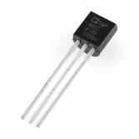
How Sensors Provide Information
LDR provides analog resistance Resistance changes based on the input. We can use this to vary the voltage into an analog input.
Light
TMP 36 provides analog voltage
Voltage varies between 0V and V_{supply} …. based on input
Temperature
Sensors allow an Arduino to gather information from its surroundings,
log certain events, and intelligently respond to various conditions.
Notes:
There are many kinds of sensors and many kinds of ways of brining their information into your Arduino.
There are many ways to get information out of sensors and into your Arduino.
In this class, we will cover 5 sensors and 5 ways of bringing in their information into the Arduino.

Slide 5


How Sensors Provide Information
HC-SR04 provides sonar timing On / Off pulse changes frequency
Distance
HC-SR501 provides a digital signal Binary (On or Off) signal, or binary coded value
Motion
Notes:
There are many kinds of sensors and many kinds of ways of brining their information into your Arduino.
There are many ways to get information out of sensors and into your Arduino.
In this class, we will cover 5 sensors and 5 ways of bringing in their information into the Arduino.

Slide 6
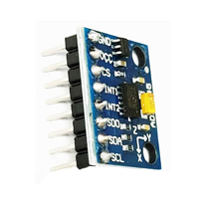
How Sensors Provide Information
ADXL345 provides detailed information on movement via serial communication.
Acceleration
Serial (UART, I²C, SPI) – Serial communication of sensor data
UART – Universal Asynchronous Receiver-Transmitter
I²C – Inter-Integrated Circuit
SPI – Serial Peripheral Interface
Notes:
There are many kinds of sensors and many kinds of ways of brining their information into your Arduino.
There are many ways to get information out of sensors and into your Arduino.
In this class, we will cover 5 sensors and 5 ways of bringing in their information into the Arduino.

Slide 7
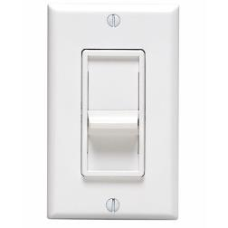
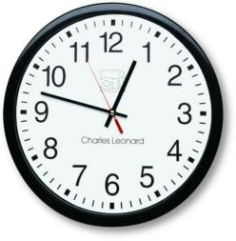
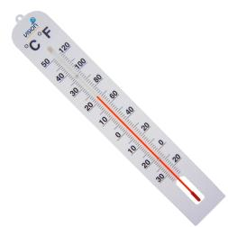
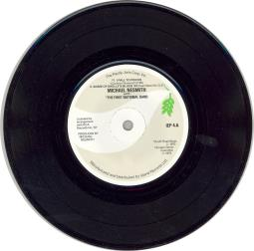
ANALOG
Reminder:
When something is analog, if varies in endless amounts.
Resistance
Time
Temperature
Sound
Notes:
Instructor: this slide offers reminders of the concept of analog, which was part of the first Arduino class

Slide 8
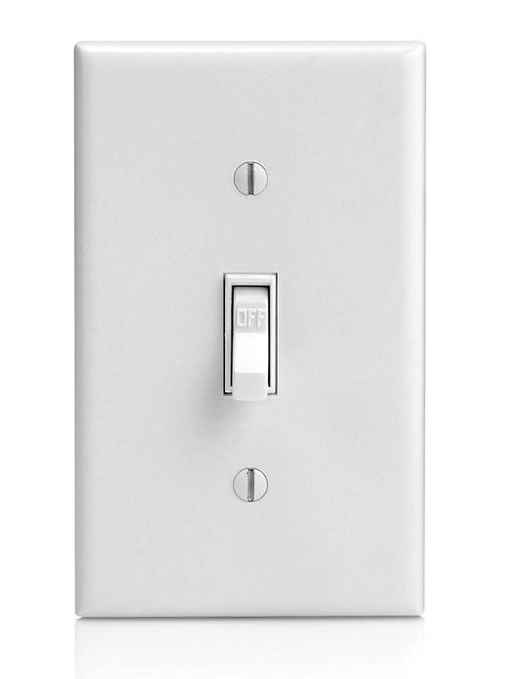
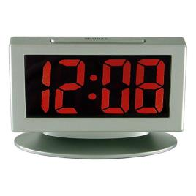
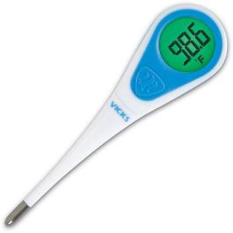

DIGITAL
Computers and microcontrollers, work with a specific number of units.
We call this digital information.
On / Off
Time
Temperature
Sound and Video

Slide 9
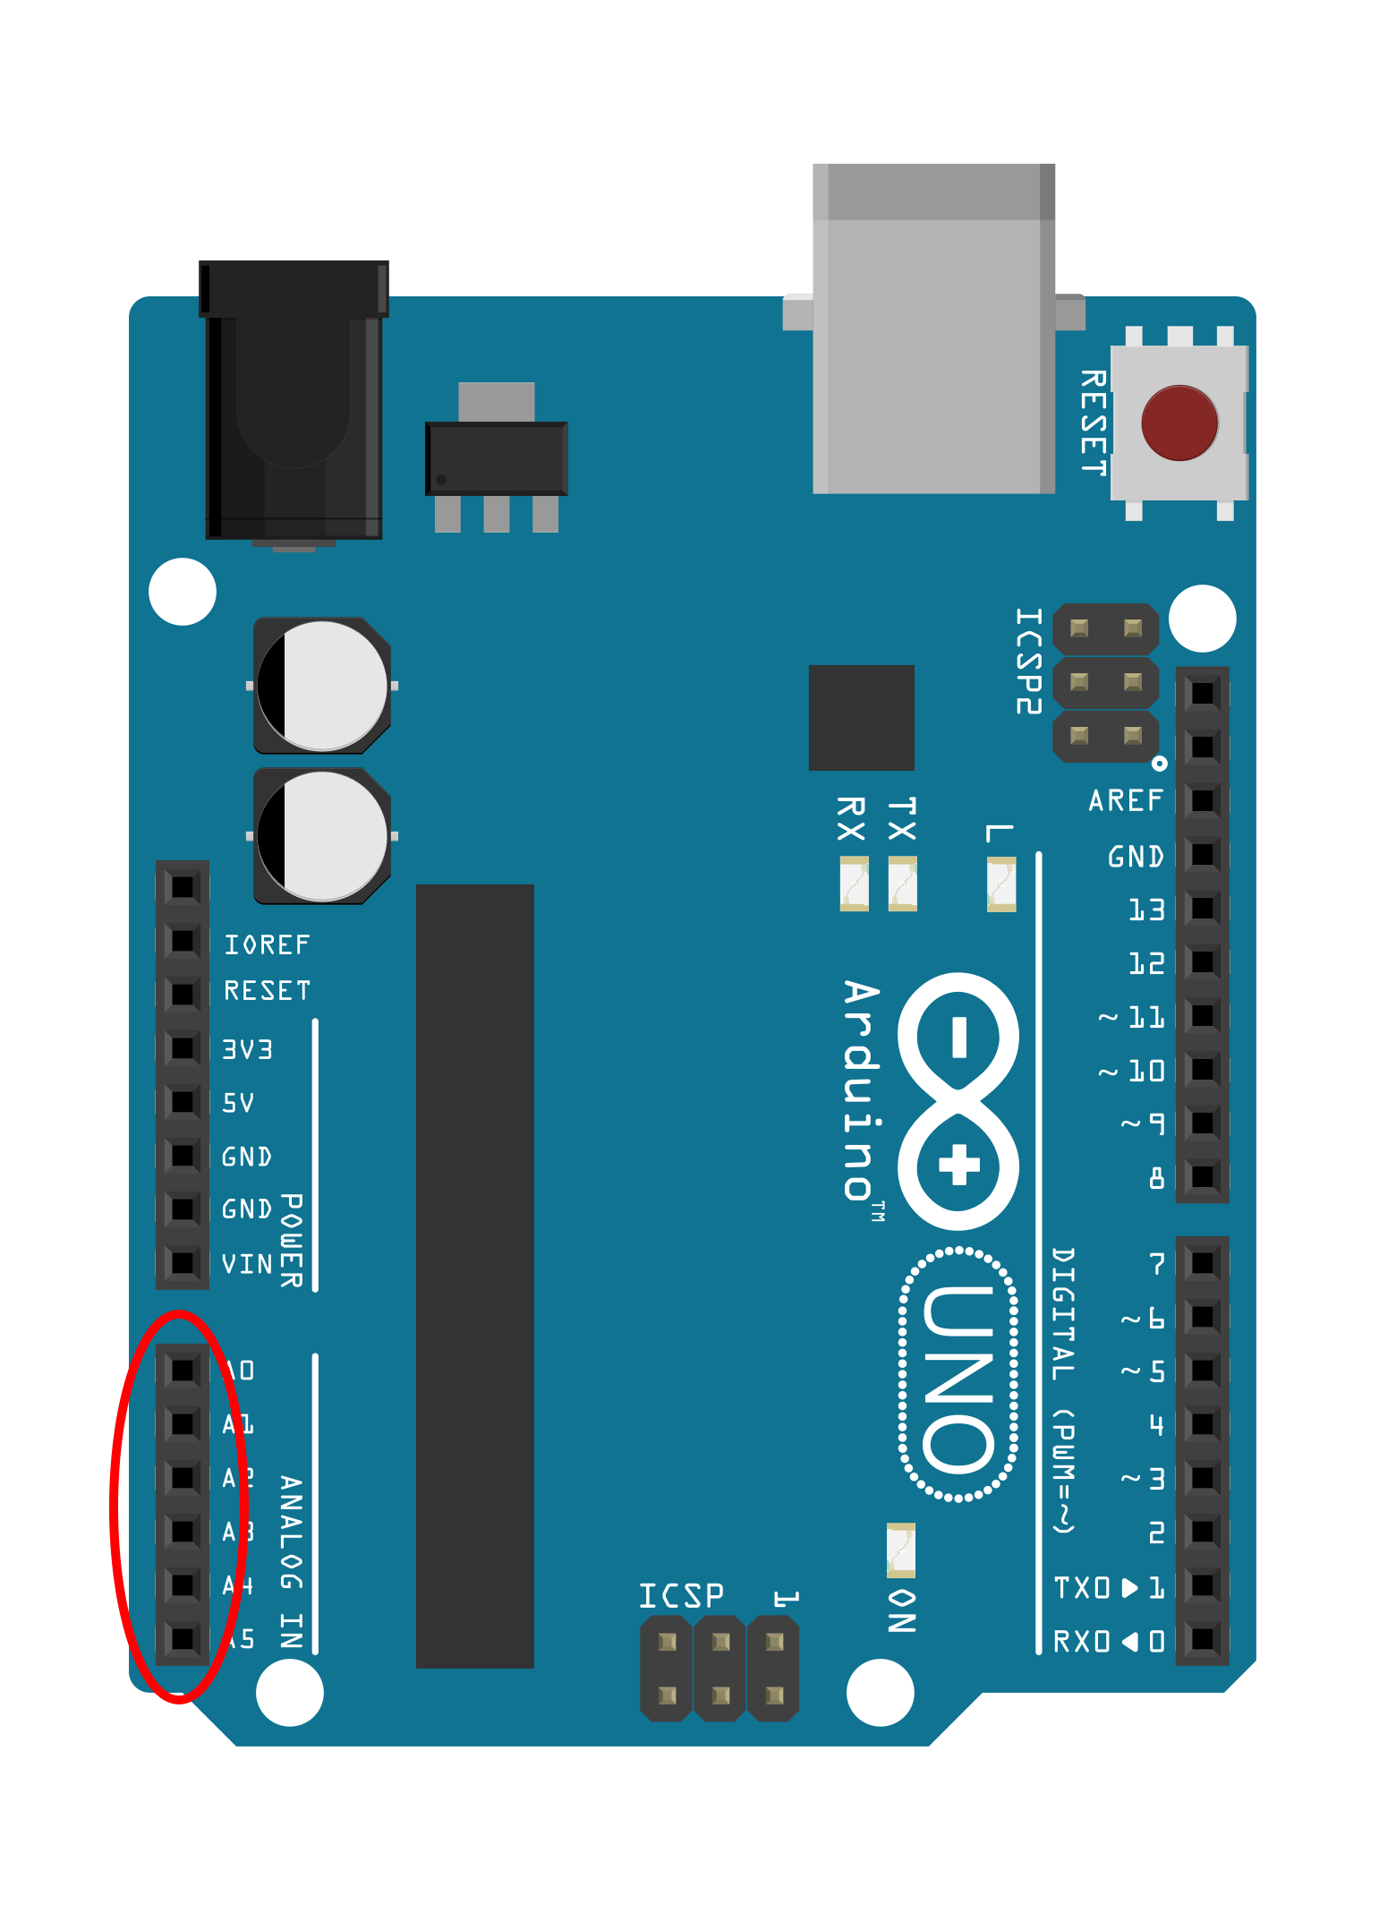
ANALOG TO DIGITAL
Use for analog input
We’ll use the 10 bit Analog to Digital Converter
0V – 5.0V
0 to 1023

Slide 10

ANALOG VOLTAGE SENSORS
The TMP36 temperature sensor runs on:
2.7V to 5.5V DC
Measures temperature from:
−40°C to +125°C
Notes:
Our first sensor will use analog voltage to give us a temperature.

Slide 11
VARIABLES
Reminder: Variables give us a way to keep track
of information and recall it as needed.
We “declare” variables to set aside space in RAM*
Declarations often occur before the setup() function
Can also be declared right when you need them
V=I*R
You may recognize the
term variable from algebra
*RAM – Random Access Memory
Notes:
We mentioned variables in our previous class. We’ll dig into more details on variables during this class.

Slide 12
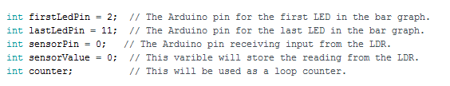
VARIABLE TYPES
There are different kinds of variables, called Value Data Types
Each type:
Uses up a certain amount of RAM
Holds certain kinds of information
Here are examples of declaring integer variables.
Notes:
Variables come in different “types” depending on the information they need to hold.
We need different types, because it takes up more memory to hold certain kinds of information.
These example shows declarations for the type “int”
Note the “=“ sign. It is an assignment operator. In other words, it “assigns” a vaule when the variable is declared.
Note that the variable “counter” is declared, but no value is assigned.

Slide 13
VARIABLE DECLARATIONS
You can declare a variable right when you need it…
…even inside a calculation
temperatureF is declared and then assigned the result of the formula.
Notes:
The float data type allows us to store very large numbers. The number can even have a fraction (a number after a decimal point)
Keep in mind that with Arduino C, the highest precision you can expect for a floating point value is 7 digits.
In other words, any math operations you perform on floating point numbers will only be accurate to seven digits after the decimal point.
Notice that float takes up twice as much space as int.

Slide 14
INT DATA TYPE
Data Type | int*
Byte length | 2 (set aside when variable is declared)
Range | -32,768 to 32,767
*short for integer – a whole number (nothing to the right of the decimal point.
Notes:
The variable type “int” has a Byte length of 2. That means that 2 Bytes of RAM are used up by each int variable we declare.
RAM is set aside even if we don’t put information into the variable.
We’ll dig into more details on variables during this class.

Slide 15
FLOAT DATA TYPE
Data Type | float*
Byte length | 4 (set aside when variable is declared)
Range | -3.4028235E+38 to 3.4028235E+38
*Short for floating point – allows fractions (numbers before and after a decimal point.)
Notes:
The temperature program uses a type called “float”
The float data type allows us to store very large numbers. The number can even have a fraction (a number after a decimal point)
Keep in mind that with Arduino C, the highest precision you can expect for a floating point value is 7 digits.
In other words, any math operations you perform on floating point numbers will only be accurate to seven digits after the decimal point.
Notice that float takes up twice as much space as int.

Slide 16
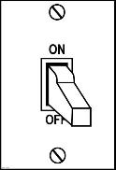
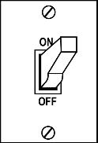
DIGITAL SENSORS
Reminder: When something is digital, it only works with a specific number of units.
(In computers and microcontrollers, there are only two units: 0 and 1)
0 | Off | Low | 0 Volts
1 | On | High | 5 or 3.3 Volts*
*“High” on an Arduino Uno is 5V. “Low” on some other microcontrollers is 3.3V.

Slide 17

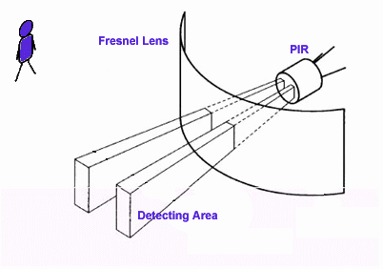
DIGITAL – BINARY (ON OR OFF) SENSOR
Passive Infrared Module (PIR) detects motion
Does not emit infrared (passive)
Two pyroelectric chips are used to detect motion
Fresnel lens is used to gather infrared light from a larger area
Makes signal pin “High” when motion is detected
≈ 110°
Notes:
The PIR sensor module is an example of a digital sensor.
This slide shows the basics of the PIR sensor module.
Two pyroelectric chips detect infrared. Motion is detected when one chip detects more infrared (heat energy) than the other.
Pyroelectric - having the property of becoming electrically charged when heated.
We’ll talk more about the settings on this module once we put it to work.

Slide 18
ACTIVITY 2
Use a PIR module and an LED to create a motion detector

Slide 19
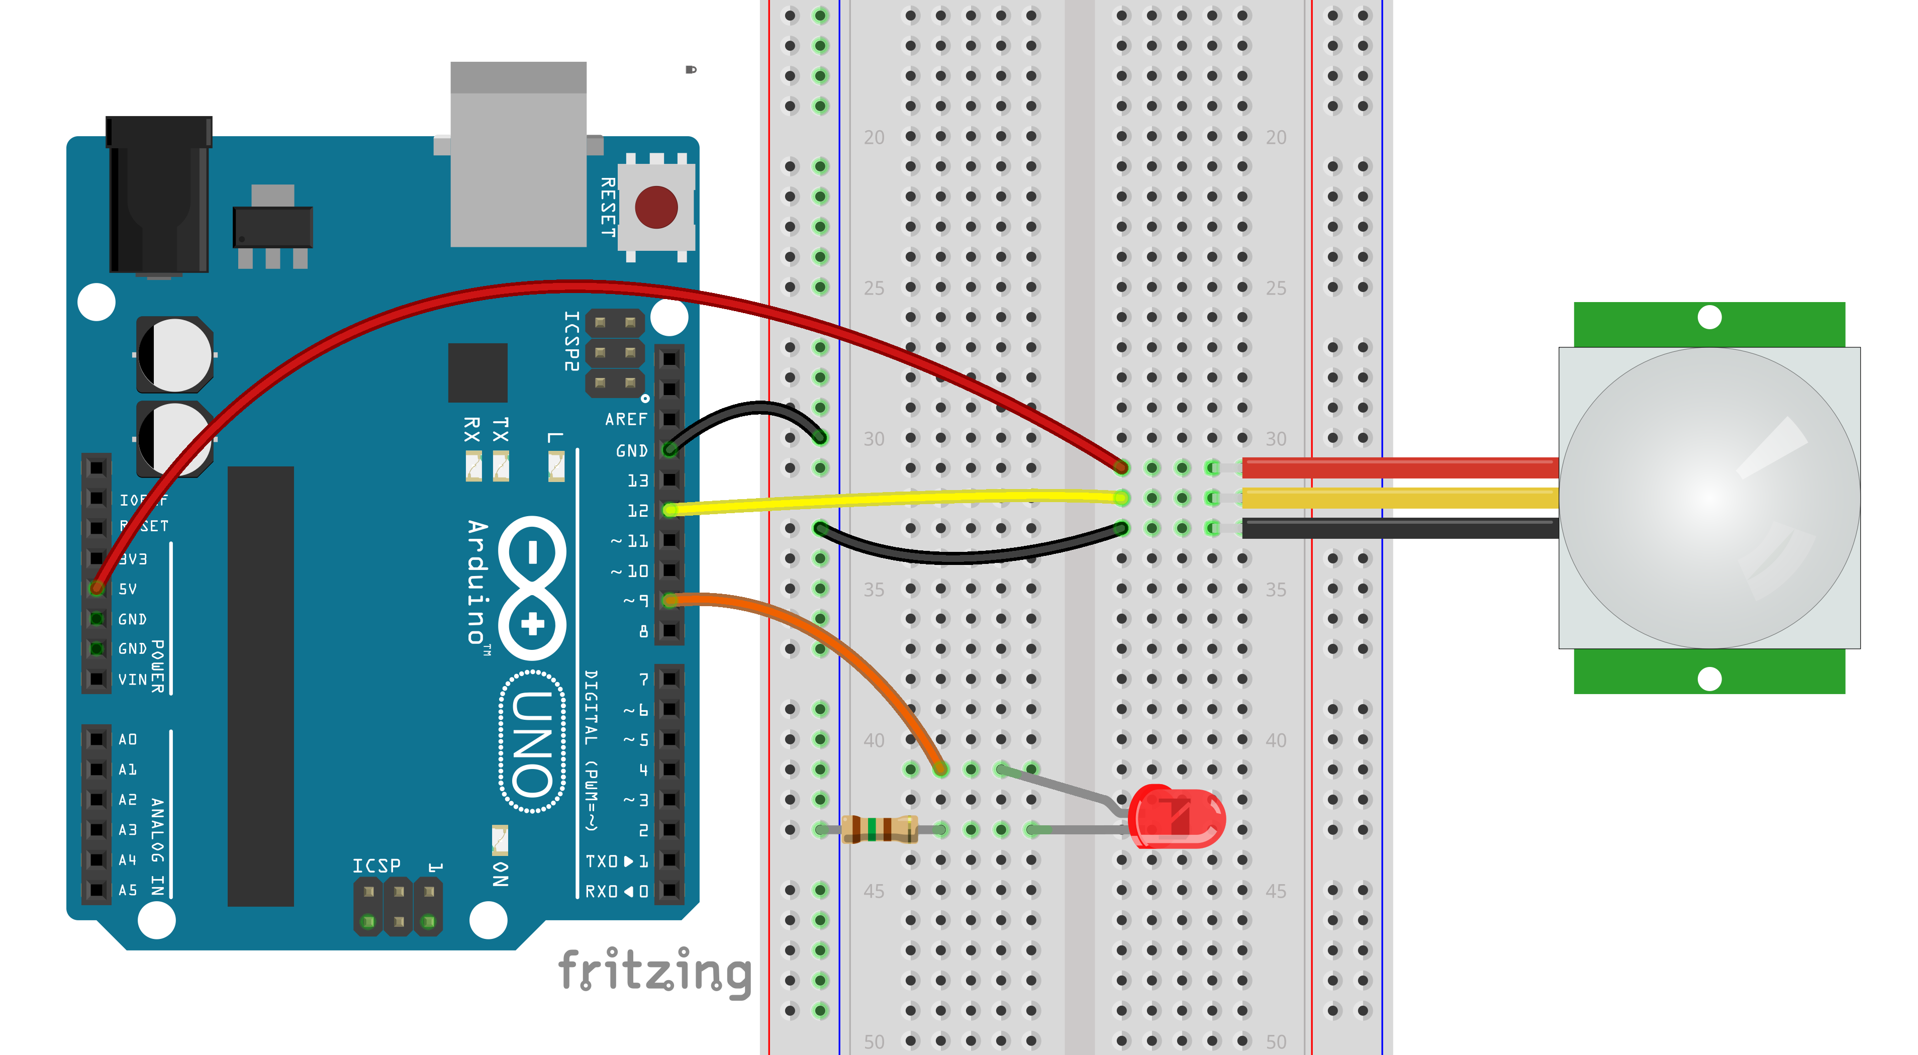
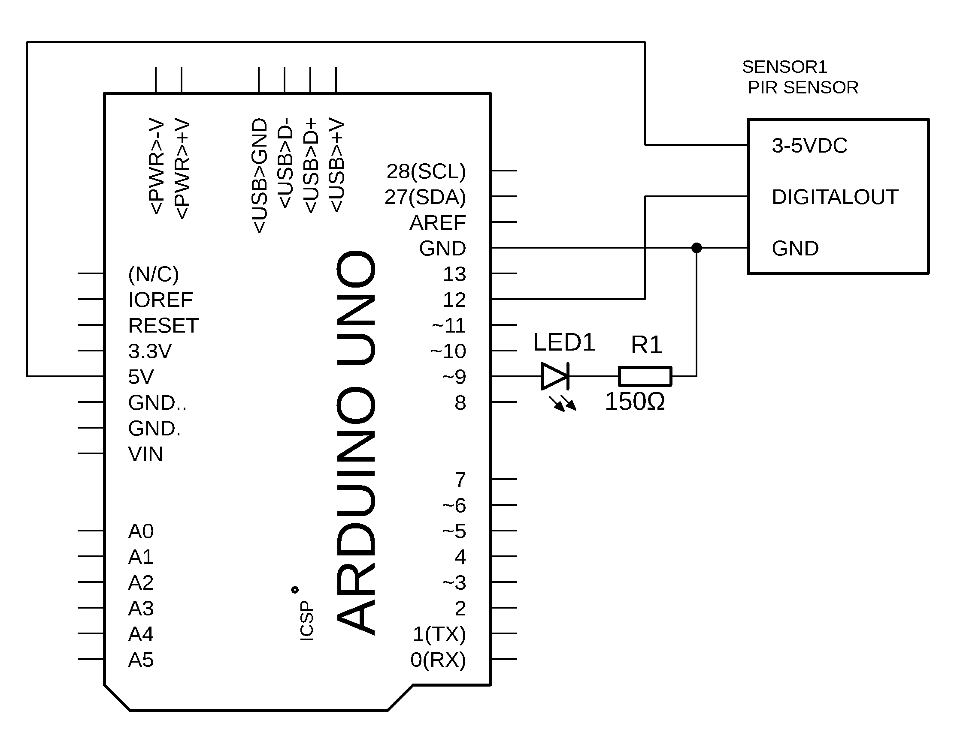
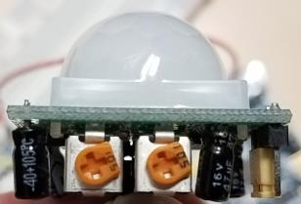
ACTIVITY 2
Doublecheck your polarity!
Turn both pots to this position:
Notes:
Remind students to open the images on their computer using the GitHub repository
Build this circuit.
The three connections for the PIR are correct using the orientation above. Information on the connections is silkscreened under the Fresnel lens.
Be sure to doublecheck your polarity.
Instructor, the PIR has a Low Drop Out 3V Regulator. It can handle 5V’s however, the USB 5V doesn’t have enough current to power the module so it is best to use the 3V3 output from the MKRZero.
Be sure to set the two pots using the settings shown. We’ll explain what they do in a little bit.

Slide 20
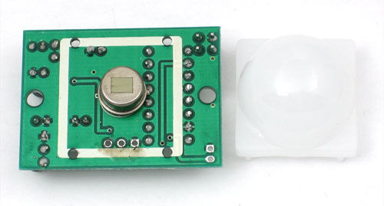
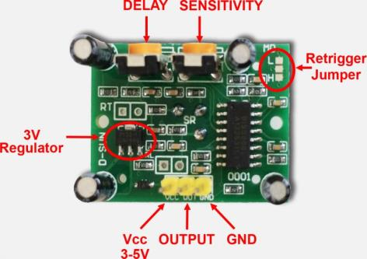
PIR SENSOR MODULE
Delay 4 to 300 seconds
Sensitivity 3m – 7m (10ft – 23ft)
Jumper setting H or L
Use “H”
H- Output remains HIGH while motion is detected.
L – Repeated HIGH/LOW pulses.
Notes:
Let’s take a closer look at the PIR module.
There are two pots that allow you to adjust settings on the PIR module.
The delay pot selects how long the output pin is kept in the “high” state.
The sensitivity pot selects the general distance where motion will be detected.
The best position for the jumper when working with Arduino’s and Rasberry Pi’s is H

Slide 21
CONDITIONALS
Conditional statements allow your programs to “make decisions”.
The if statement:
If (expression)
{ // Start of if statement block
// This executes only if the expression is true
} // End of if statement block
Notes:
Remember that all statements executed when the expression is met must be between the curly braces.

Slide 22
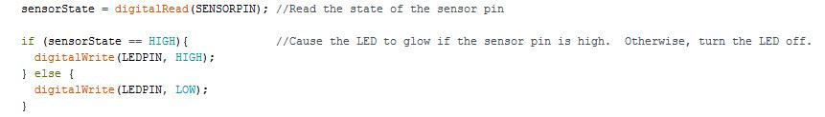
CONDITIONALS
If (expression)
{ // Start of if statement block
// This executes only if the expression is true
} // End of if statement block
Runs if expression is not true
Notes:
Notice the conditional from our current sketch. If sensorState is equal to HIGH, that means motion was detected…. So the LED is set to high.
Otherwise, the LED is set to low.
Technically the “else” isn’t needed. You could simply have a statement that sets the LED low. We use the else to make the decision more clear.
NOTE: One “=“ is used to assign a value to a variable. Two “==“ is used to check equality.

Slide 23
CONDITIONALS
If (expression)
{ // Start of if statement block
// This executes only if the expression is true
} // End of if statement block
Notice the double “=“,
it means “is equal to”
Notes:
Notice the conditional from our current sketch. If sensorState is equal to HIGH, that means motion was detected…. So the LED is set to high.
Otherwise, the LED is set to low.
Technically the “else” isn’t needed. You could simply have a statement that sets the LED low. We use the else to make the decision more clear.
NOTE: One “=“ is used to assign a value to a variable. Two “==“ is used to check equality.

Slide 24
CONDITIONALS SUMMARY
The if statement checks for a condition and executes the following statement or set of statements if the condition is 'true'.
if (condition) {
//statement(s)
}
An else clause will be executed if the condition in the if statement results in false.
else {
//statements(s)
}
Notes:
Notice the conditional from our current sketch. If sensorState is equal to HIGH, that means motion was detected…. So the LED is set to high.
Otherwise, the LED is set to low.
Technically the “else” isn’t needed. You could simply have a statement that sets the LED low. We use the else to make the decision more clear.
NOTE: One “=“ is used to assign a value to a variable. Two “==“ is used to check equality.

Slide 25
CONDITIONALS SUMMARY CONTINUED
An else if block may be used to test specific conditions.
A terminating else block is not required.
An unlimited number of such else if branches are allowed.
if (condition1) {
// do Thing A
}
else if (condition2) {
// do Thing B
}
else {
// do Thing C
}

Slide 26
RELATIONAL OPERATORS AKA CONTROL OPERATORS
!= (not equal to) < (less than) <= (less than or equal to) == (equal to) > (greater than) >= (greater than or equal to)
Operator - A symbol that usually represents an action or process.

Slide 27
REVISTING VARIABLE DECLARATIONS
We use variables so we can save, update and recall information
while a program is running.
Notes:
You may remember from last time that we use variables to hold on to important information.
A variable must be declared before it is used.

Slide 28
VARIABLE DECLARATIONS
Declare without an assignment:
int LEDPIN;
Declare with an assignment:
int LEDPIN = 9;
Notes:
You can declare variables anytime within a sketch. However, when a variable will be used throughout a sketch, it is best to declare it before the Setup() function.

Slide 29
VARIABLE DECLARATIONS
Sometimes you may want to keep track
of information that won’t change.
You can do that by adding const to a declaration:
Variables declared with const
are often written in all caps.
const int LEDPIN = 9;
The compiler will not allow you to change the
assignment of a variable when it is set as a constant.
Notes:
It is very handy to keep track of GPIO pins at the beginning of a sketch. That way you can quickly change those pin assignments should the need arise.
Const is a data type modifier. Variables declared with const cannot be changed during the course of a program.
As we’ve seen before, it is very handy to set the values for pins at the beginning of a sketch. That way you can easily change pin assignments if the need arises.

Slide 30
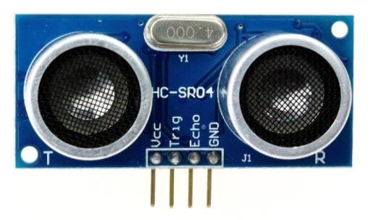
SENSORS USING TIMING
HC-SR04 Sonar Module
Sends out an ultrasonic “ping” and then waits for an echo.
Arduino can be used to compare the time difference.
VCC: 5V
Measuring angle: 15°
Range: 2cm – 400cm (1” – 13’)
Notes:
It’s time to move on to our next method of communication and our next sensor.
The HC-SR04 is an example of a timing based sensor.

Slide 31
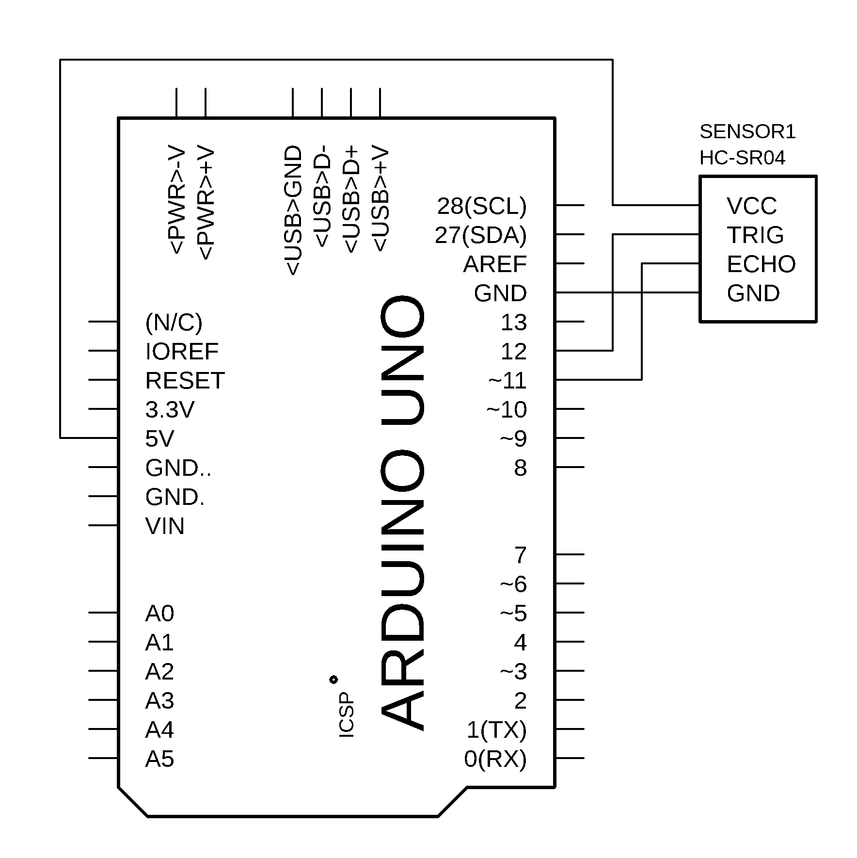
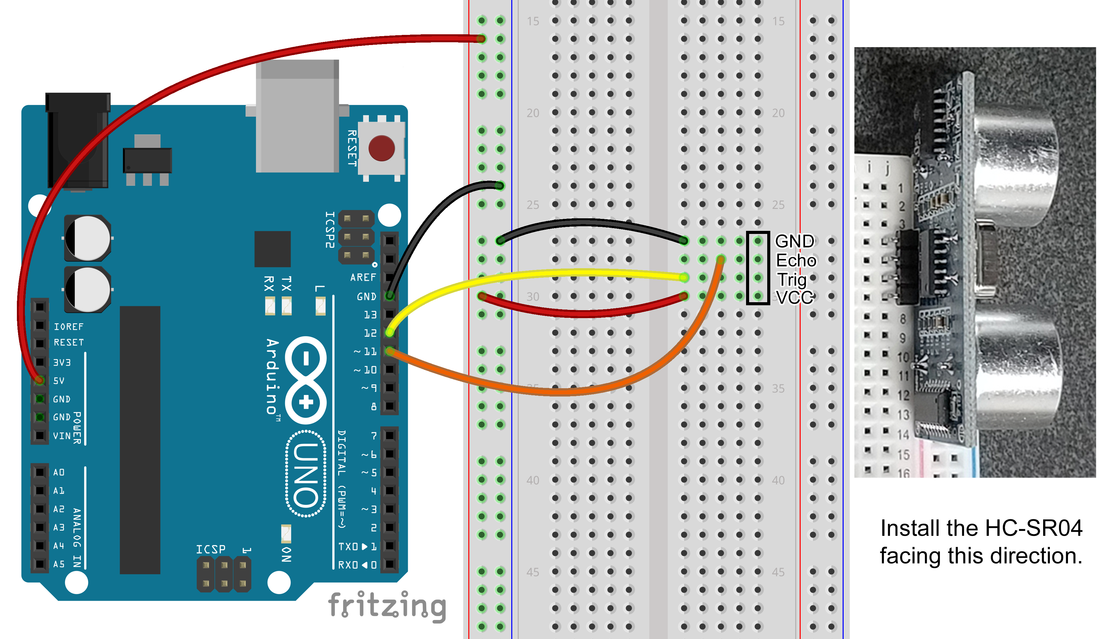
ACTIVITY 3
Notes:
Remind students to load the setup pictures from the GitHub page and then build this activity.
Doublecheck all connections before they hook up the USB connection.

Slide 32
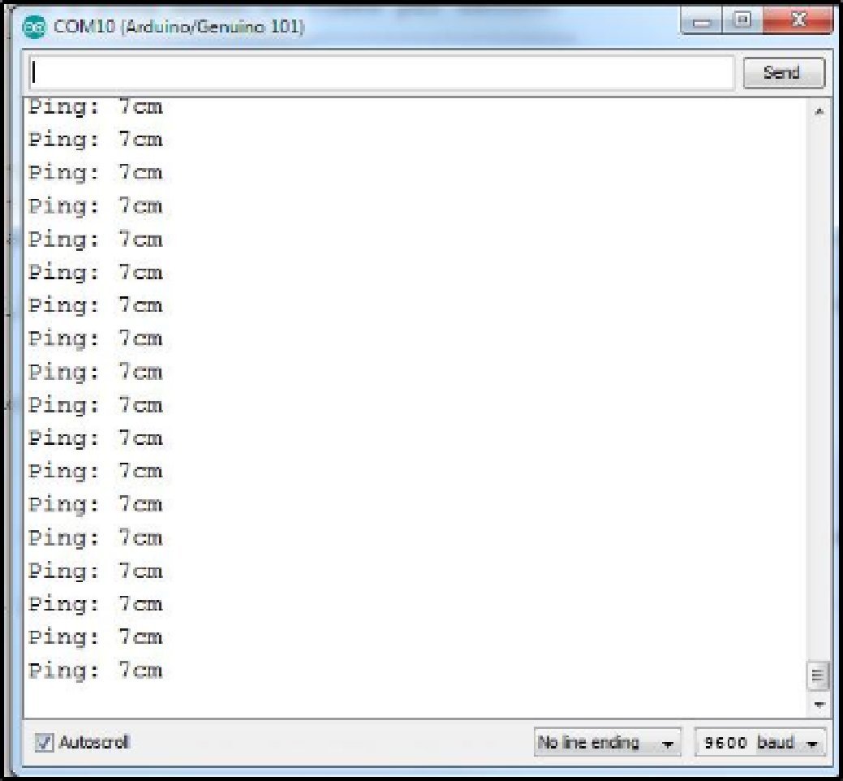
OPEN SERIAL MONITOR
Arduino reads the distance and sends it to the serial monitor.
Must be 9600
Notes:
Let’s talk a little more about how the HC-SR04 works…

Slide 33
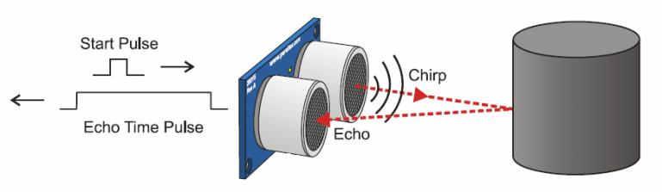
USING THE HC-SR04
Sketch action | HC-SR04
Sends 10µs pulse to Trigger | Sends out 8 40KHz pulses & waits for return.
Listens on Echo pin | Sends pulse out Echo pin.
Receives pulse on Echo pin | Duration of pulse tells round trip distance.
Divides distance in half
Returns distance to target in cm
Notes:
The HC-SR04 is an example of a timing based sensor.

Slide 34
The function tone()
Generates a square wave of the specified frequency (and 50% duty cycle) on a pin.
A duration can be specified, otherwise the wave continues until a call to noTone(pin).
The pin can be connected to a piezo buzzer or other speaker to play tones.
Must be a pin that can provide PWM (marked with ~)
Tone(pin, frequency, duration);

Slide 35
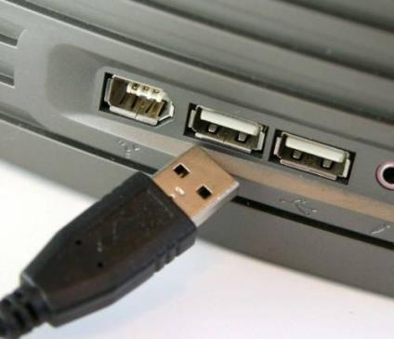
SERIAL COMMUNICATION
Serial Communication is the process of sending data one bit at a time.
Supports two-way communication
Uses as little as two wires
Signal
Ground
Universal Serial Bus (USB)
is a popular type
of serial interface.
Notes:
Our next type of sensor uses serial communication.
In serial communication, data is sent one bit at a time.
So far, we’ve used one type of serial communication with the Arduino … the Universal Serial Bus (USB).
USB requires support circuitry, which takes up space and power.
Your Arduino is capable of using other serial standards.
Let’s look at three of them.

Slide 36
SERIAL COMMUNICATION
Two popular standards for serial communication:
I²C – Inter-Integrated Circuit (TWI) (SMBus)
SPI bus – Serial Peripheral Interface bus
Notes:
These are three popular serial communication methods and Arduino boards support all three of them!
Each kind requires slightly different connections and programming.
We’ll be using I²C in this class

Slide 37
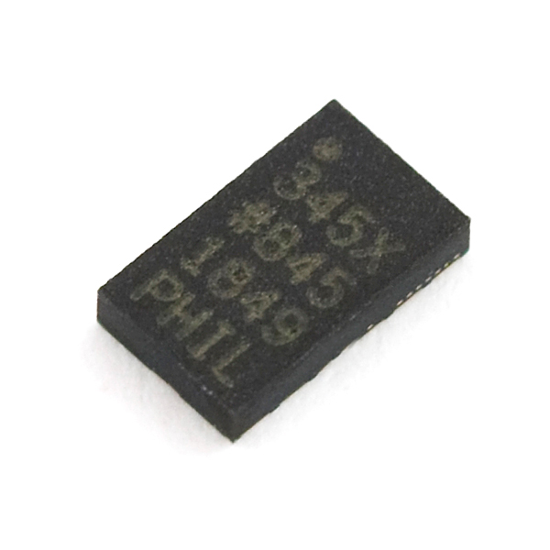
SERIAL COMMUNICATION SENSORS
The ADXL345 chip detects acceleration and sends
the information over an I²C or SPI connection.
We’ll use a breadboard friendly “breakout” circuit board and I²C connections.
Notes:
The ADXL345 is a surface mount accelerometer chip. We don’t have a way of connecting a surface mount chip to our breadboard. So we’ll use a development board. Development boards are used to test chips that can’t ordinarily be breadboarded.

Slide 38
ACTIVITY 4
Read information from ADXL 345 accelerometer using an
I²C serial connection and display it on the serial monitor.

Slide 39
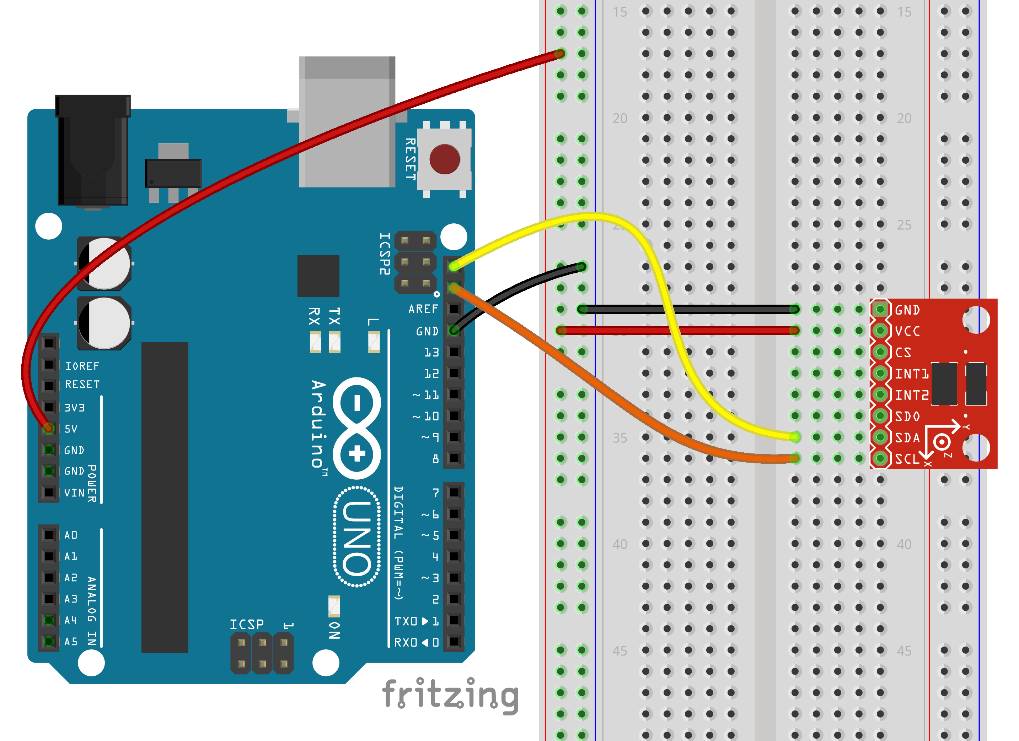
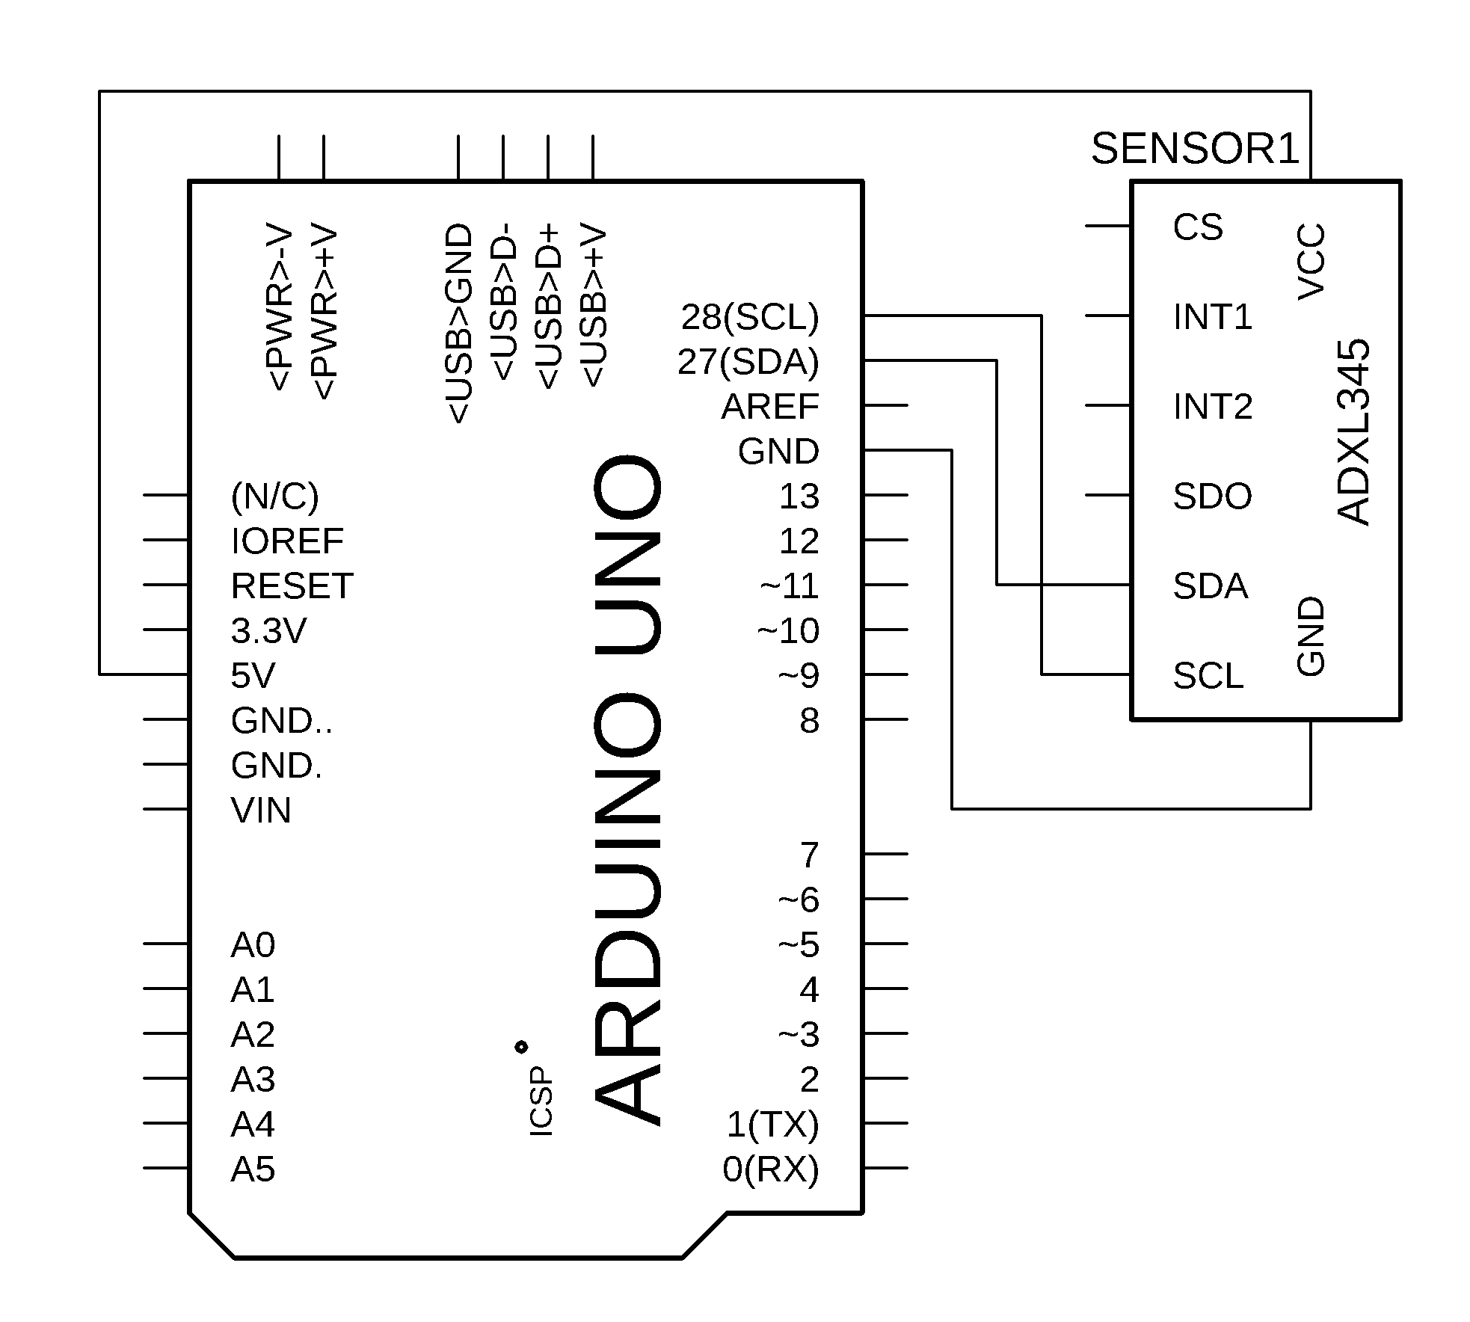
ACTIVITY 4
Notes:
Have students build this circuit using the ADXL345 module
Instructor, the pullup resistors needed for I2C are built into the Grove ADXL345 module.

Slide 40
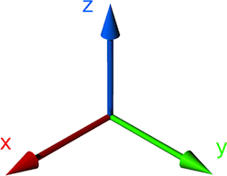
LIBRARIES
Function - A body of code designed to perform a specific task.
Library - A group of functions that have been precompiled into a library file.
We can use libraries to add new capabilities to our programs.
(i.e. we can add a library to support the ADXL345)
Notes:
Before we work with our accelerometer, we need to teach our Arduino how to talk to it.

Slide 41
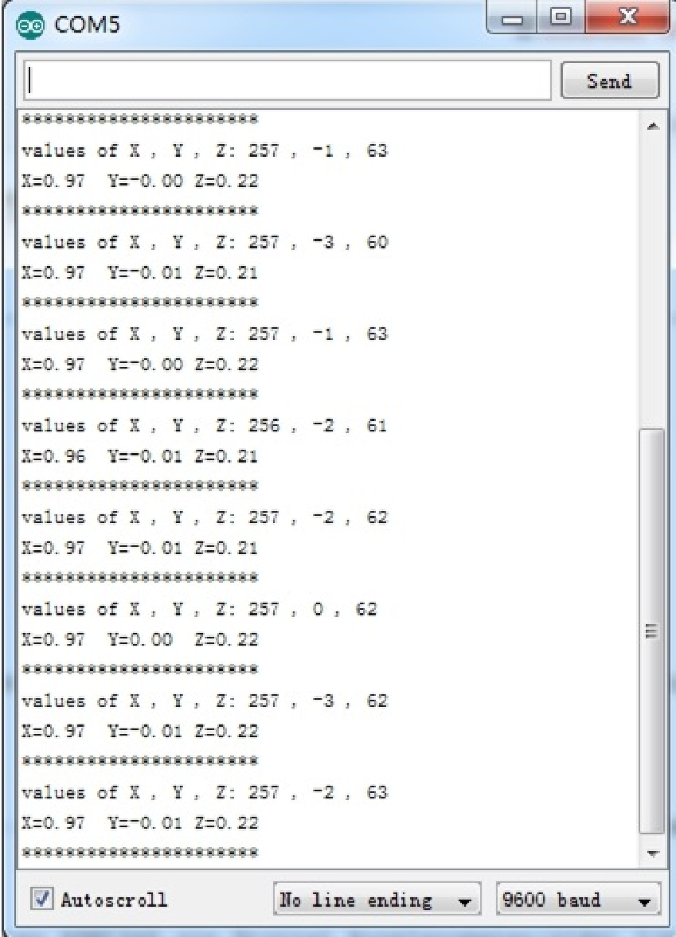
OPEN SERIAL MONITOR
Arduino reads X, Y & Z acceleration
and sends it out the serial port.
Must be 9600
Notes:
Have students rotate the breadboard back and forth and up and down.
Caution: warn them not to pull the USB cord and not to bang the breadboard on the table
Note that Z access is up and down.

Slide 42

ADXL345 ACCELEROMETER
Measures up to ±16 g in X, Y & Z axis
Communicates through SPI or I²C (we’ll use I²C)
Useful for tilt-sensing, acceleration or shock
Detects single or double taps
Detects free-fall
Magnetometer (compass)
Accelerometers are an integral part of drones and some robots.

Slide 43
I²C SERIAL COMMUNICATION
I²C – Inter-Integrated Circuit
Two connections (in addition to power)
Clock Signal (SCL)
Data Signal (SDA)
Requires pull-up resistors on both connections require pull-up resistors to hold them “high”.
Can support up to 1008 devices via separate addresses.
Notes:
The I²C protocol was invented by Phillips in the early 1980s and standardized in the 1990s.
I²C is a licensed standard. Devices that didn’t pay the license fee are called TWI or Two Wire.
Since each device has its own address, you can talk to multiple devices via the same two wires (in addition to power)

Slide 44
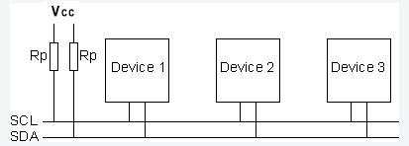
I²C SERIAL COMMUNICATION
All devices connect to the same two wires, the I²C bus.
Each device must be on a separate address.
Pull up resistors on the two wires must be placed on both SCL and SDA.
Notes:
When sending data, an I²C device pulls the data line low. We use resistors to restore the signal to high when now device is asserting it low.
These two resistors are built into the module from Seed, but that won’t be true for all ADXL345 modules from different manufactures. Be sure to check the documentation!

Slide 45
I²C SERIAL COMMUNICATION
We use the library, Wire to add support for I²C.
#include <Wire.h>

Slide 46
I²C SERIAL COMMUNICATION
The ADXL345 has an address of 0x53 and an
alternate address of 0x1D by setting the SDO pin high.
We used a library designed for this module,
so the address was already good to go within our sketch.
#include <ADXL345.h>

Slide 47
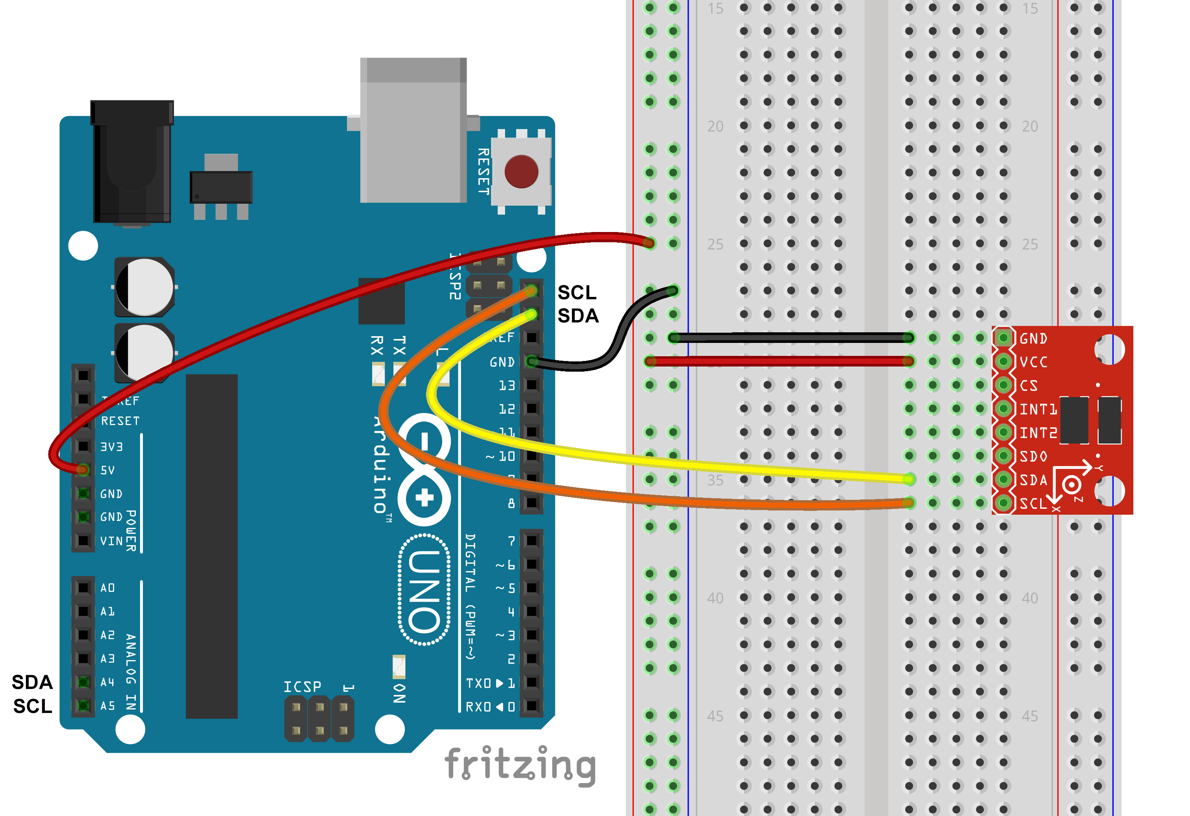
I²C SERIAL COMMUNICATION
Arduino UNO has two locations for I²C communication

Slide 48
EXAMPLES OF I²C DEVICES
3-axis accelerometer
3-axis magnetometer
Clocks / Calendars
Displays
Light sensors
Relays
Temperature and Humidity sensors
This is just a few examples.
The website https://i2cdevices.org/ has ten pages of I2C devices.

Slide 49
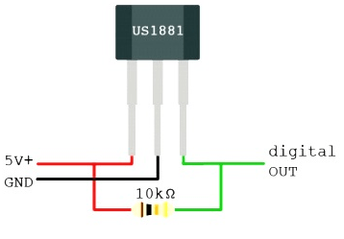
US1881 Hall Effect Sensor
Latching hall effect* sensor.
Turns ON when a magnetic field from a magnet is applied.
Turns OFF when the reverse field is applied
*Hall effect - The production of a voltage difference (the Hall voltage) across an electrical conductor,

Slide 50
ANALOG RESISTANCE
Photocells change their
resistance based on exposure to light.
The brighter the light, the lower the resistance.
Another name for these devices is LDR.
LDR – Light Dependent Resistor
Notes:
Photcells are an example of an analog sensor.

Slide 51
ACTIVITY 5
Create a light meter using a Light Dependent Resistor and 5 LEDs.
Notes:
In this activity, we’ll use a Light Dependent Resistor to create a light meter.
The meter will be 10 LED’s. The more light there is, the more LED’s will light up.
Remember that the LDR is an analog device. So we need to receive information from the LDR from an Analog pin.
We will turn on the 10 LED’s using 5 Digital pins.

Slide 52
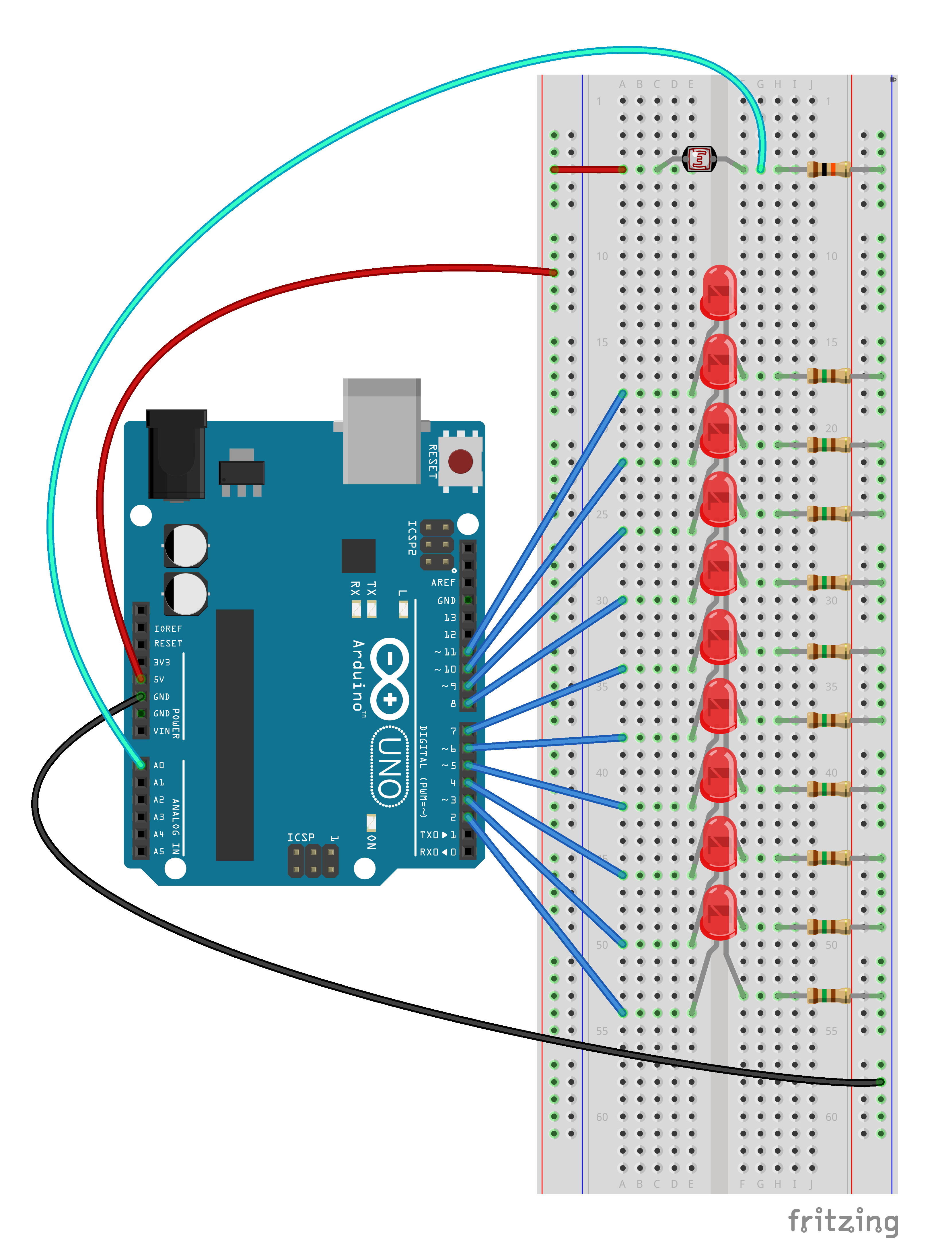
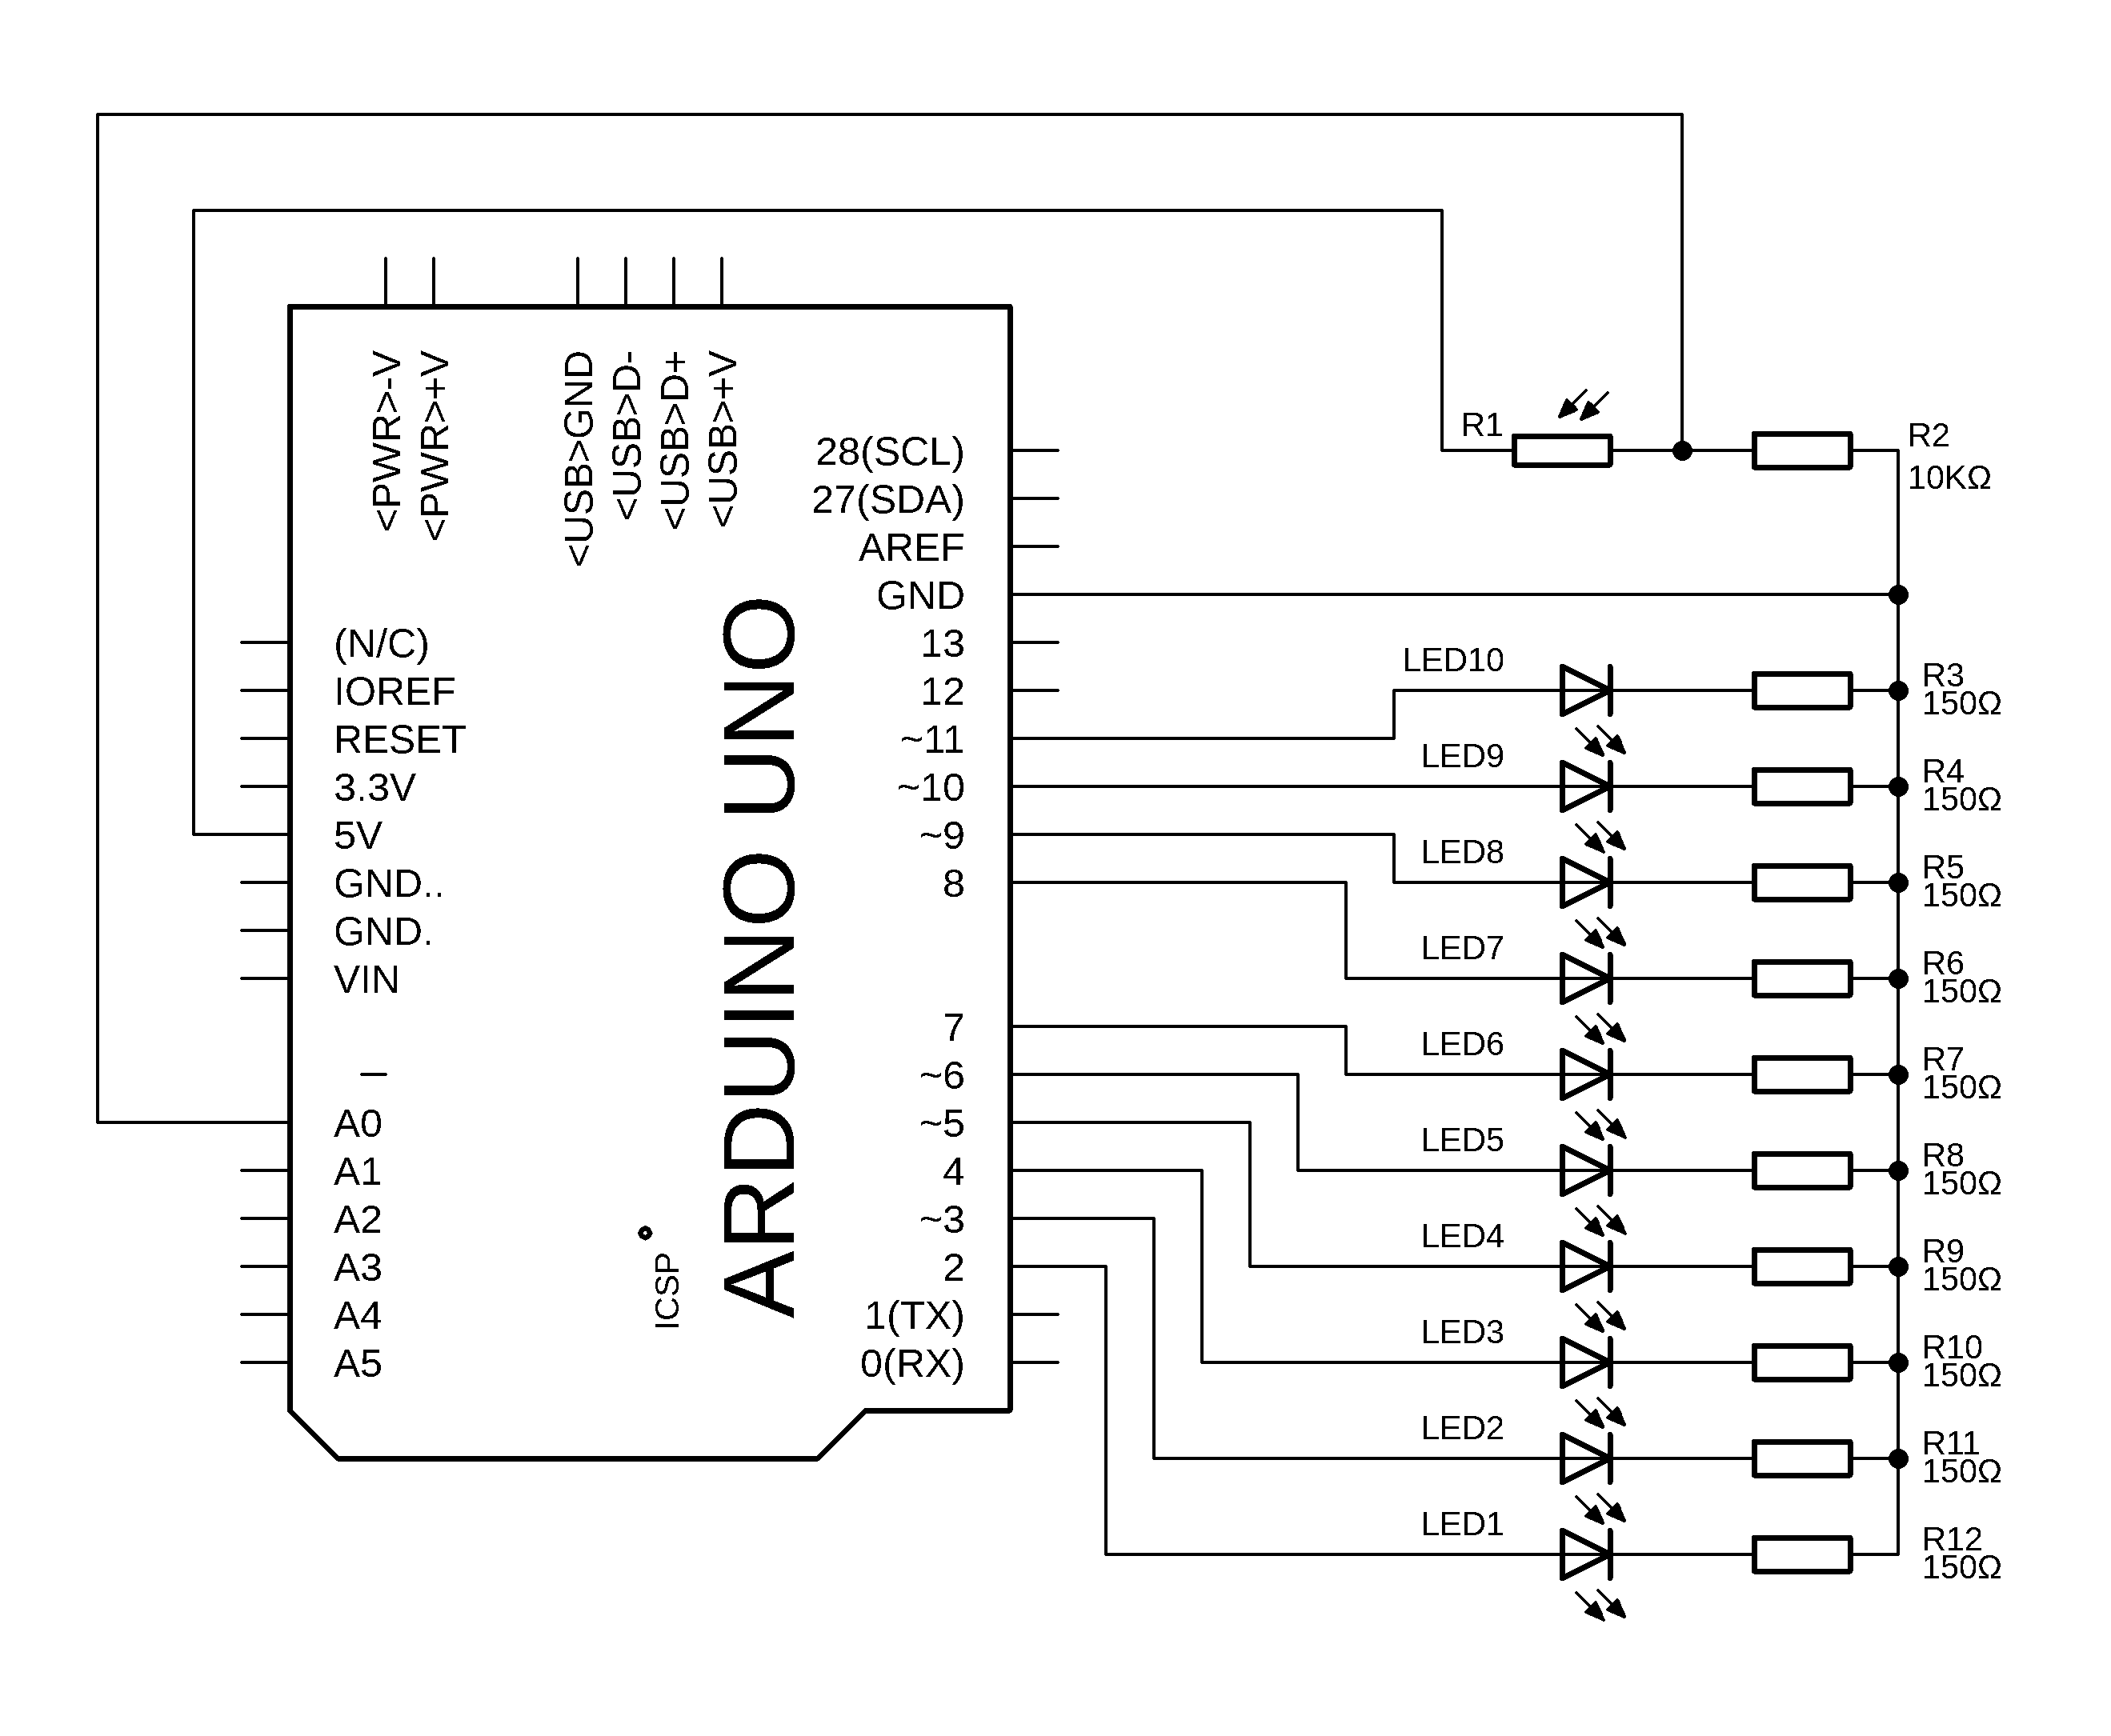
ACTIVITY 5
R3 – 7 150Ω Resistors (Brown, Green, Brown)
R2 10KΩ Resistor (Brown, Black, Orange)
Notes:
Build this circuit.
The best thing to do is connect all the LEDs (long lead on the left side)
Then connect the resistors, then all the jumpers
In this class, we will be giving you both the breadboard layout and the schematic layout.
Notice that we put a space between each of the LED’s. This helps ensure that the they can sit upright without bumping in to each other.

Slide 53
ACTIVITY 5
R1 & R2 create a voltage divider.
Generates an analog signal that
varies between 0 and 5V
Lots of light:
Resistance of LDR is low – Analog pin is close to 5V
Little light:
Resistance of LDR is high – Analog pin is close to 0V (GND)

Slide 54
DATA TYPES FOR NUMBERS
Type | Byte length | Range of values
boolean | 1 | Limited to logic true or false
unsigned char | 1 | 0 to 255
byte | 1 | 0 to 255
int | 2 | -32,768 to 32,767
unsigned int | 2 | 0 to 65,535
long | 4 | -2,147,483,648 to 2,147,483,647
unsigned long | 4 | 0 to 4,294,967,295
float | 4 | -3.4028235E+38 to 3.4028235E+38
double | 4 | -3.4028235E+38 to 3.4028235E+38
Notes:
There are other data types in Arduino C. However, these are the most common.

Slide 55
DATA TYPES FOR LETTERS
Type | Byte length | Range of values
Char | 1 | -128 to + 127 or single ASCII* character
String | Varies | A list of characters
*ASCII – American Standard Code for Information Interchange
Each letter is represented by a single Byte of data.
01000001(decimal 65) = A
01100001(decimal 97) = a
Notes:
Most variable types in Arduino C are indented for numbers. We have two that are used for letters (A-Z).
The computer isn’t actually storing a “letter” instead it is storing a 8-bit binary code that represents a letter.
Notice that upper and lower case letters have a separate code.

